Slide 1
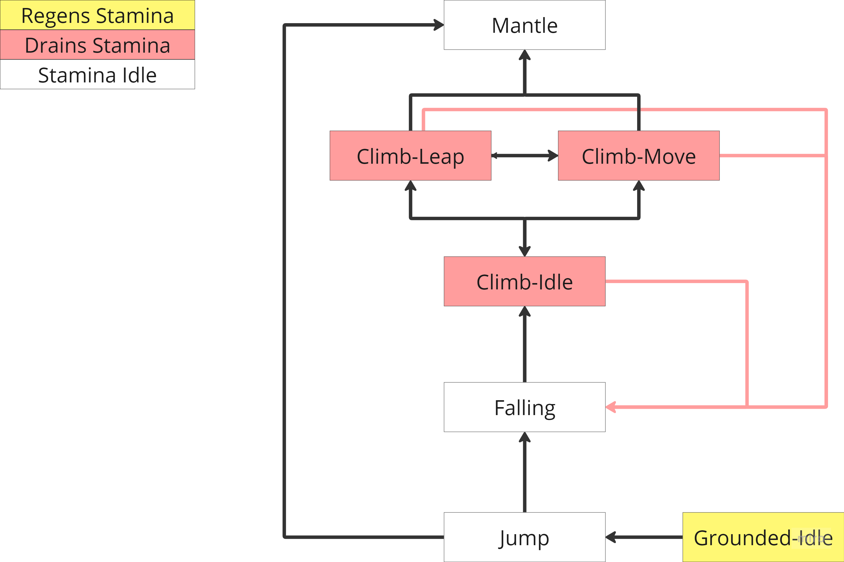
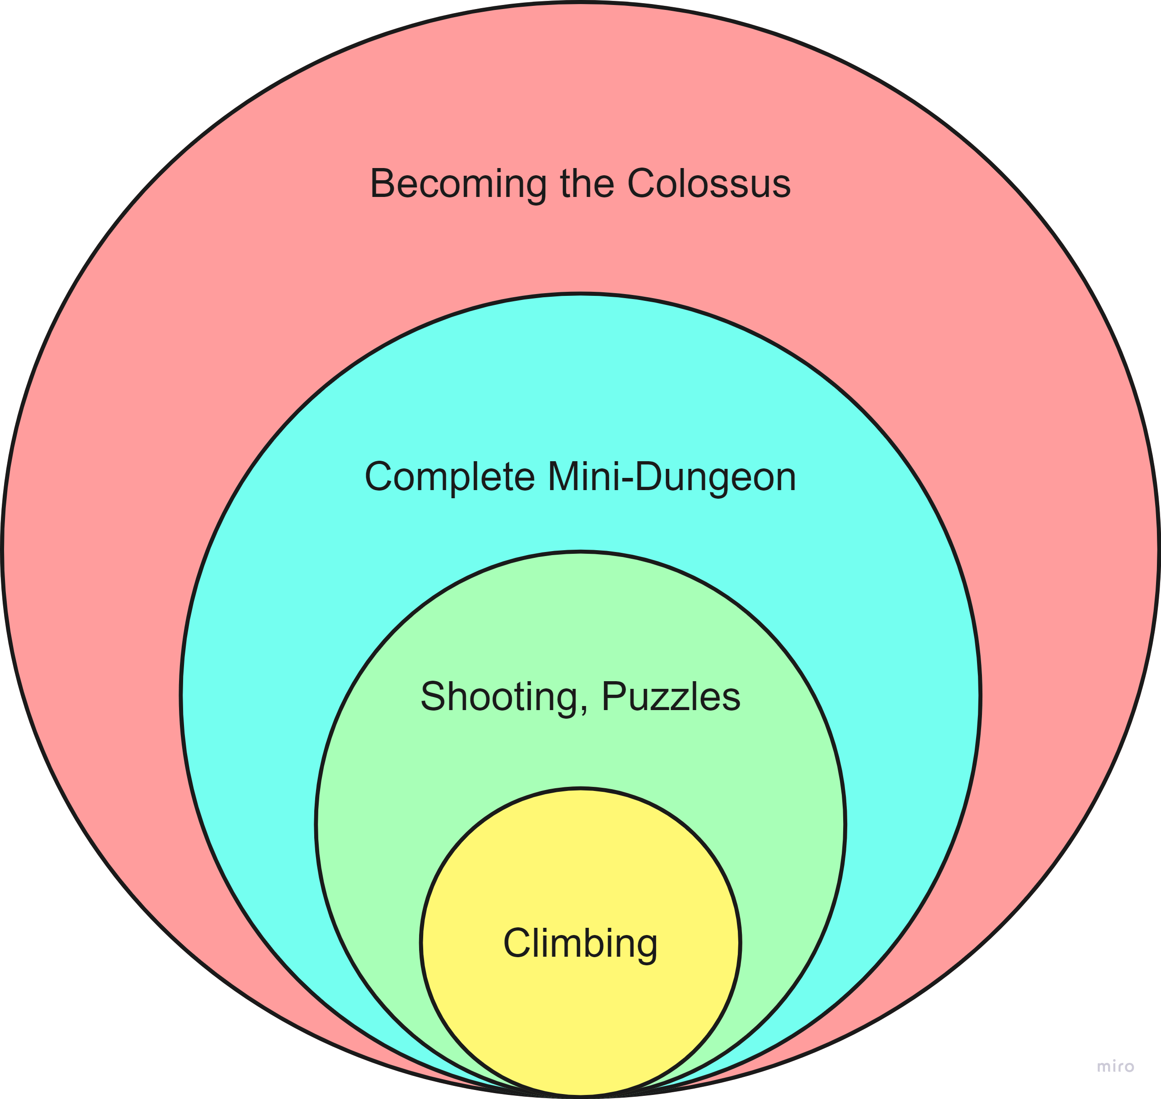
Climbing System
A system that allows the player to move vertically and horizontally on a wall to traverse the colossus. This also includes a system to move horizontally on ledges. This system is closely intertwined with all other core systems like Bow, Anchor and stamina.
Design Intent
The player needs to make interesting choices on what path to climb based on how much stamina he has and how much stamina the path requires.
Specifications
The level designers need to be able to specify which meshes are climbable. Not everything is climbable.
Designers should be able to specify how much stamina each climbing action (Input related) takes.
Climbing needs to be accessible from all states except for actions on input. (Jumping, Walking, Falling)
Weather systems affect climbing.
Player can mantle up to be grounded again.
Players can leap while climbing to spend stamina to gain more distance. (If not, enough stamina is left to leap, still leap but use all remaining stamina.)
If the player is out of stamina, he will start fall down.
The climbable angle of a wall should be max 45 degrees, if this is lower he transitions to walking.
References
Climbing animation pack
Legend of Zelda Climbing system
Flow
Action | PC Input | Controller
Jump | Space | A
Climb | Movement keys | L Stick
Let go | Left Ctrl | B

Slide 2
Feature architecture
An outline of the architecture for the climbing feature from a PR perspective.
Feature will be built as a: plugin / part of the game project
Dependencies:
Outline of dependencies, for example 'ALSR'
Functionality that gets exposed for Designers ( Blueprint Side ):
Functions
Outline functions this feature affects and in what way
Components
Outline components this feature affects and in what way
Variables
Based on the previous slide, outline variables and mark which ones will be exposed for design.
Total list of all assets required for presentable state in development.

Slide 3
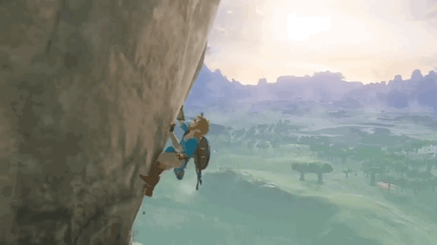
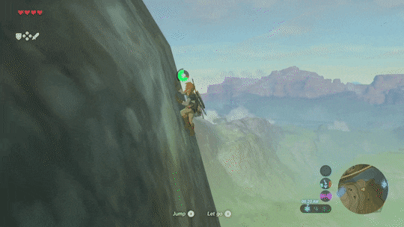
Audiovisual Assets
The climbing system requires animations to have a clear view of the metrics. These can be solved with asset packs or custom animations. A preference is towards asset packs so that metrics can be defined way earlier. Audio is required for moving around on the wall and VFX too.
Asset list:
Animations
A good asset pack we could get is this one: Link Preview
Climbing-Idle
Climbing movement.
Up
Down
Left
Right
Leap
Up
Down
Left
Right
Mantle.
VFX
Attach to wall poof. (Based on environment.)
Leap from wall poof. (Based on environment.)
Audio
Climbing Steps (like foot steps but for hands when climbing.)
Attach to wall.
Leap from wall
Out of stamina breath getting louder.
Out of stamina fall. (Scream?)
Visual Aid
SKETCHES / VIDEOS HERE!
Scream?

